Slide 1
BANA 7038: Final Project
Presented by:
Aishwarya Pawar
Rinisha Marar
Sharang Nimbalkar

Slide 2
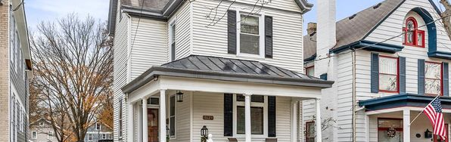
AIM
Project to build a linear regression model to predict the house prices in Cincinnati area using our self-collected data.
Our goal was to develop a model that would predict the value of houses in the area of Cincinnati. For the analysis purpose, we split the dataset into covariates and select a response variable.

Slide 3
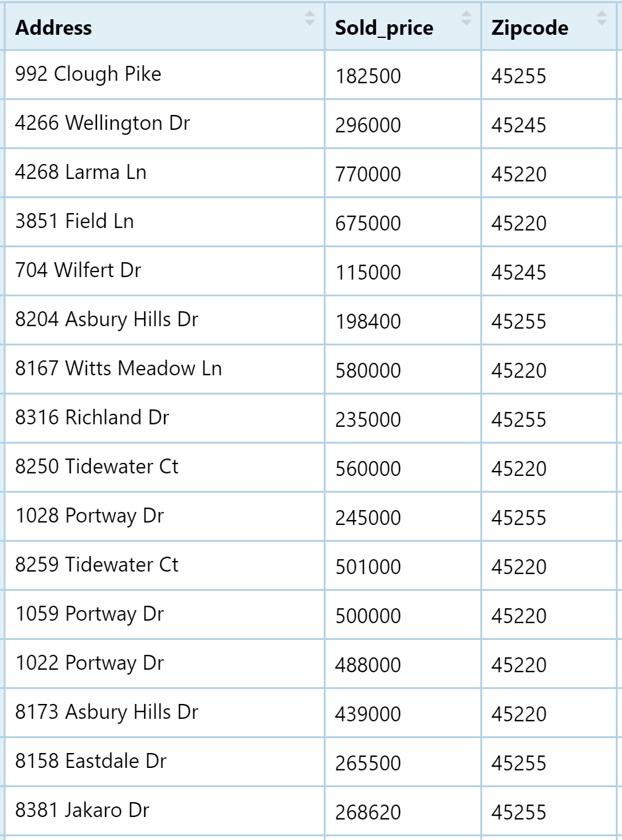
Data Exploration and Data Cleaning
“
add cool wisdom here
Collected a total of 202 records from www.trulia.com and www.zillow.com for analysis in R.
Cleaned the data by eliminating missing values.
Analyzed the relationship between the response variable and covariates by summarizing the model.
john wishper
CEO

Slide 4
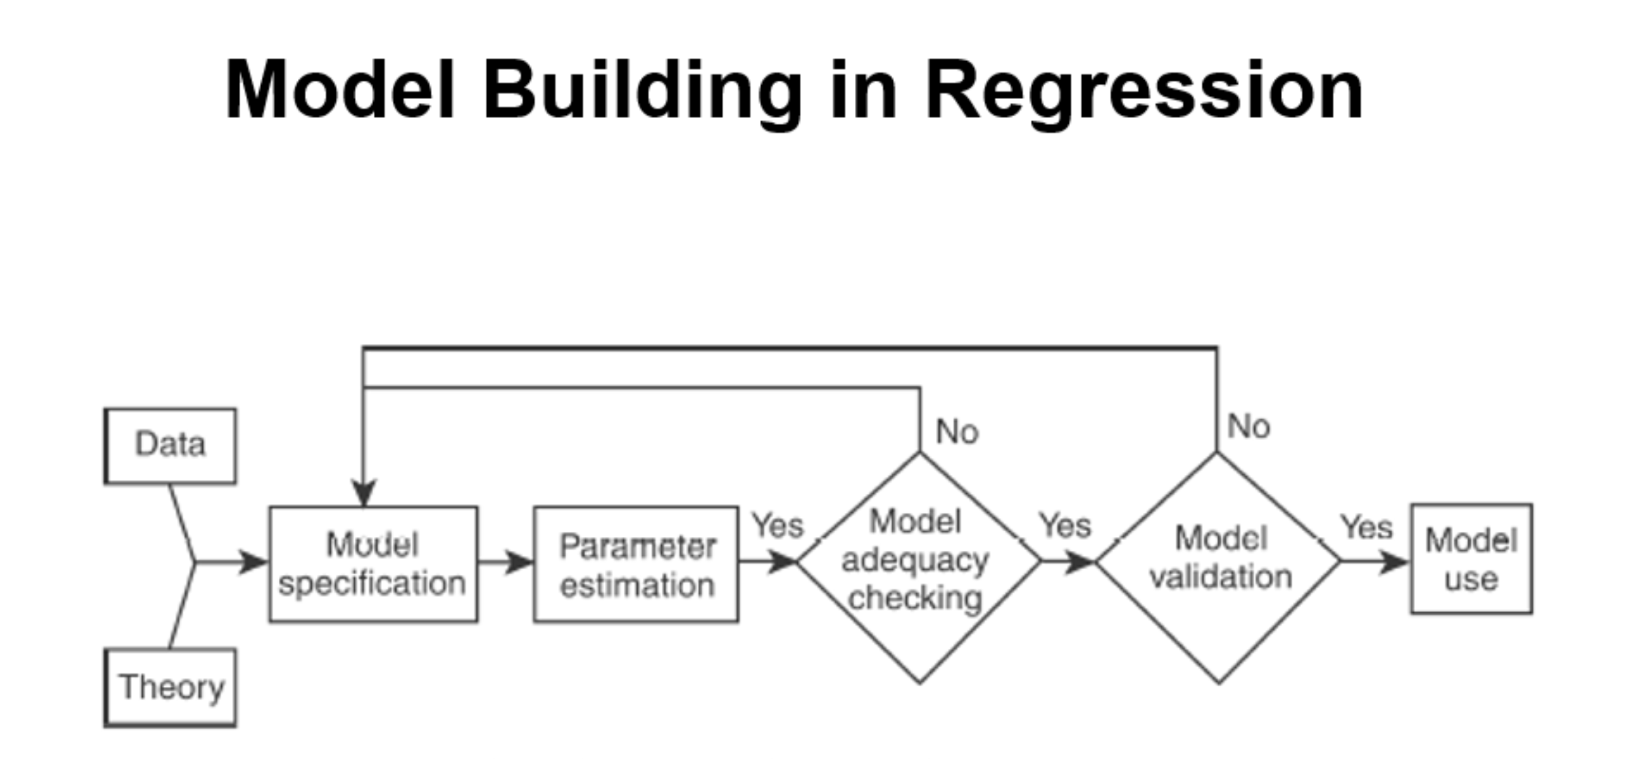

Slide 5
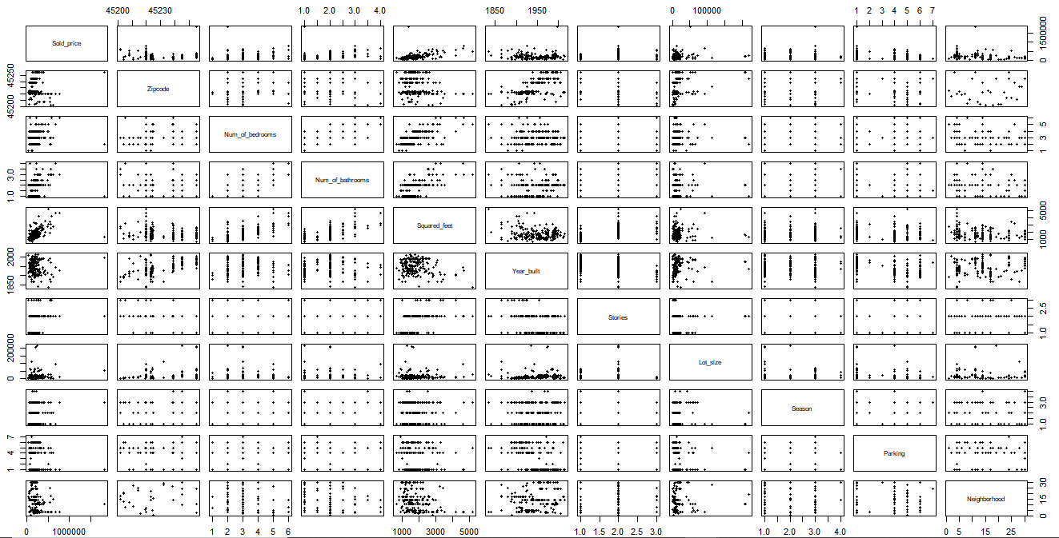
Data Visualization
To detect the patterns and outliers in the housing dataset. Where sold price and squared feet have a strong linear relationship.

Slide 6
Model Adequacy Check
Transformation
Multicollinearity
Residual Analysis to check the LINE assumptions
Linear relationship
Independent errors
Normally distributed error: Bow Shaped
Equal Variance: Bow Shaped
Transforming the data to fix the violations in LINE assumptions
Box-Cox Transformation; lambda = 0
Hence applied Log transformation to our response variable
No multicollinearity exists.
5 < Variance Inflation Factors < 10

Slide 7
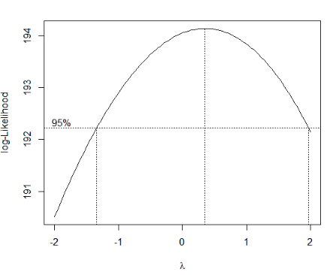
Box-Cox Transformation

Slide 8
Predicting the price of the house using the following equation
Finalizing the module

Slide 9
Prediction
To estimate the market price of a house with the covariates squared feet area and neighborhood.
Prediction 1
Address: 6586 S Oak Knoll Dr
Prediction 2
Address: 3249 Avery Ln
Actual Sold Price: $165,000
Actual Sold Price:
$425,000
Predicted Sold Price: $161,549
Predicted Sold Price: $424786.4
Deviation: $3451
Deviation: $213.6
https://www.trulia.com/p/oh/cincinnati/6586-s-oak-knoll-dr-cincinnati-oh-45224--2097743354
https://www.trulia.com/p/oh/cincinnati/3249-avery-ln-cincinnati-oh-45208--2046941153

Slide 10
Future enhancement
Collecting similar neighborhood dataset to enhance the predictability

Slide 11
Thank You

